Slide 1
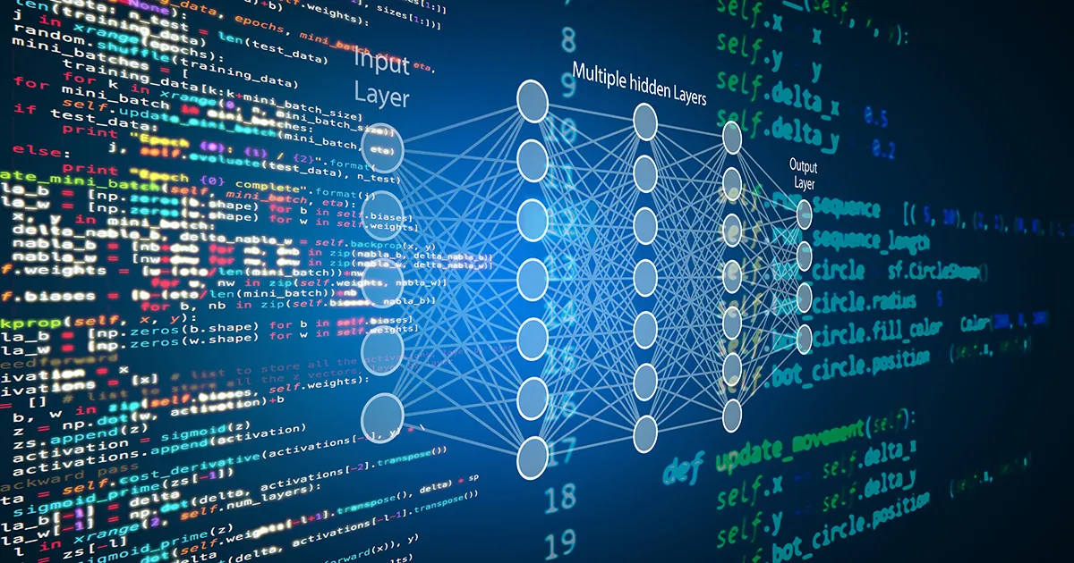

A Network of painters
Data engineering I. – Term 2
Alina Kurmantayeva
Gréta Zsikla
Mihály Hanics
Péter Török
06 December 2024

Slide 2
Agenda
1. Executive Summary
2. KNIME Workflow
3. Neo4j Operation
4. Analytics Results
Summary of project scope, data source and aim of the analyses
Overview of the KNIME workflow implementation
Outlining the network analytics carried out in Neo4j and KNIME
Overview of key analytics results and network visualization

Slide 3
Agenda
1. Executive Summary
2. KNIME Workflow
3. Neo4j Operation
4. Analytics Results
Summary of project scope, data source and aim of the analyses
Overview of the KNIME workflow implementation
Outlining the network analytics carried out in Neo4j and KNIME
Overview of key analytics results and network visualization

Slide 4
Our project work utilized 2 databased, an API and NoSQL solutions to analyse the network of painters in depth
PainterPalette database
Database containing the details of more than 10,000 painters
Extensive data cleaning
Clean to combine the datasets' artist lists effectively
API Calling
Utilizing the Wikipedia API to enrich data with artist details
Save processed data
Data joining
Improved join, and filtered exhibitions for the joined artists
Neo4j operations
Network analysis with applying Neo4j functionalities
Load processed data
E-flux announcements database
Online portal for announing various art exhibitions worldwide
Extensive data cleaning
Clean to combine the datasets' artist lists effectively
KNIME Server (ETL Implementation)
Partial outputs

Slide 5
Agenda
1. Executive Summary
2. KNIME Workflow
3. Neo4j Operation
4. Analytics Results
Summary of project scope, data source and aim of the analyses
Overview of the KNIME workflow implementation
Outlining the network analytics carried out in Neo4j and KNIME
Overview of key analytics results and network visualization

Slide 6
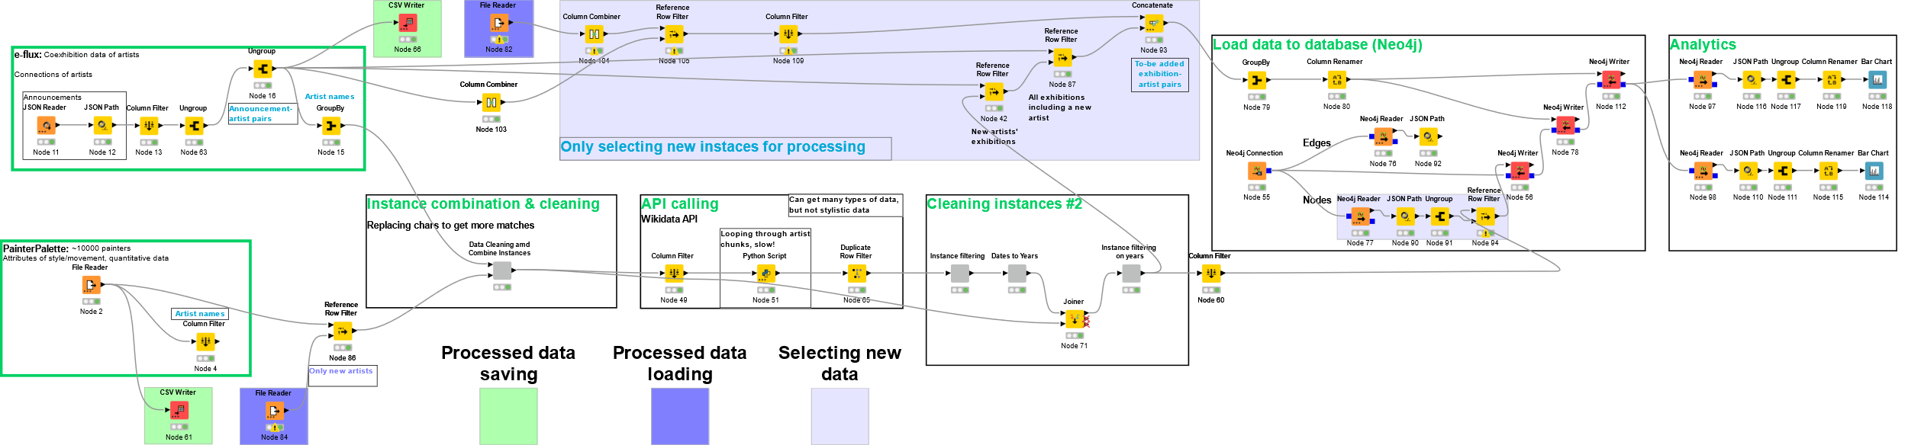
Our project work relies on a complex KNIME workflow that reads, cleans, aggregates and analyses data
Data process processing layer
Data cleaning
API Calling
Data cleaning #2
Load to Neo4j DB
Analytics

Slide 7
Each layer of the KNIME workflow has a clearly defined function, intricately interconnected to efficiency
Function | Reading and processing of the PainterPalette and eflux announcements containing artists and exhibitions | Extensive cleaning and standardization of names to implement the joining of the databases more effectively, resulting more matches | Application of API calls to enrich data with further details of artists (e.g., date and place of birth, citizenship etc.) | Connecting the KNIME workflow with Neo4j: load data into database, create and analyze network of artists
Output | Two databases with non-standardized record names and missing values | Joint database of exhibitions and standardized name artists. From 1012 to 1152 matches | Joint database with matching names and enriched data | Analytical insights and visualization of the network
Methods | File reader GroupBy JSON reader Column filter | GroupBy String manipulation | SparQL querying Python script (knio.Table) Retries on failures | Neo4j reader Neo4j connector
Data reading & import
Data cleaning & join
API implementation
Neo4j & Analytics

Slide 8
Each layer of the KNIME workflow has a clearly defined function, intricately interconnected to efficiency
Function | Application of API calls to enrich data with further details of artists (e.g., date and place of birth, citizenship etc.)
Output | Joint database with matching names and enriched data
Methods | SparQL querying Python script (knio.Table) Retries on failures
API implementation
SELECT ?person ?personLabel ?placeOfBirthLabel ?dateOfBirth...
WHERE { VALUES ?personLabel { {people_string} }
?person ?label ?personLabel.
?person wdt:P31 wd:Q5.
?person wdt:P19 ?placeOfBirth.
?person wdt:P569 ?dateOfBirth.
...
SERVICE wikibase:label { bd:serviceParam wikibase:language "en". } }
SparQL: Properties, values (identifiers), string labels
Query first paralel, retry missing instances, then retry for all languages
Transform result list of dicts into Pandas dataframe, then KNIME IO table

Slide 9
Each layer of the KNIME workflow has a clearly defined function, intricately interconnected to efficiency
Function | Reading and processing of the PainterPalette and eflux announcements containing artists and exhibitions | Extensive cleaning and standardization of names to implement the joining of the databases more effectively, resulting more matches | Application of API calls to enrich data with further details of artists (e.g., date and place of birth, citizenship etc.) | Connecting the KNIME workflow with Neo4j: load data into database, create and analyze network of artists
Output | Two databases with non-standardized record names and missing values | Joint database of artists and the recent exhibitions with standardized names | Joint database with matching names and enriched data | Analytical insights and visualization of the network
Methods | File reader GroupBy JSON reader Column filter | GroupBy String manipulation | SparQL querying Python script (knio.Table) Retries on failures | KNIME Neo4j extension Neo4j Connector Neo4j Writer, Reader
Data reading & import
Data cleaning & join
API implementation
Neo4j & Analytics

Slide 10
Agenda
1. Executive Summary
2. KNIME Workflow
3. Neo4j Operation
4. Analytics Results
Summary of project scope, data source and aim of the analyses
Overview of the KNIME workflow implementation
Outlining the network analytics carried out in Neo4j and KNIME
Overview of key analytics results and network visualization

Slide 11
Our Neo4j integration is running on a server and uses the standardized datasets as inputs to create a network graph
Neo4j connection (AuraDB)
Set up connection to a common instance on AuraDB (free).
2.
Add edges (Neo4j Writer)
Adding artist exhibitions as edges of the graph, creating connections between nodes
4.
Add nodes (Neo4j Writer)
Adding artist names as nodes of the graph. Two inputs used:
Neo4j connection node
Artist table
Graph querying (Reader)
Analysing the final graph and answering analytical questions
Neo4j connection node
Artist table
1.
3.

Slide 12
Agenda
1. Executive Summary
2. KNIME Workflow
3. Neo4j Operation
4. Analytics Results
Summary of project scope, data source and aim of the analyses
Overview of the KNIME workflow implementation
Outlining the network analytics carried out in Neo4j and KNIME
Overview of key analytics results and network visualization

Slide 13
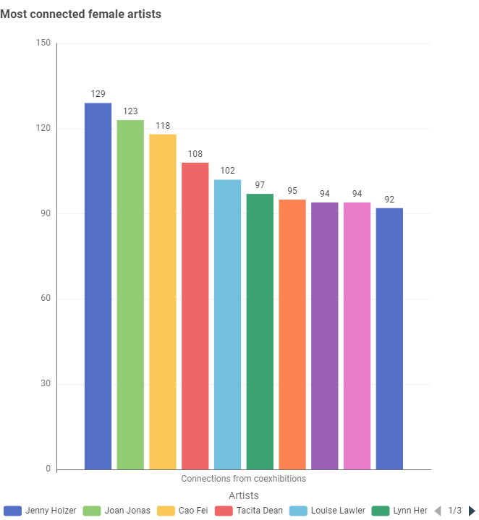
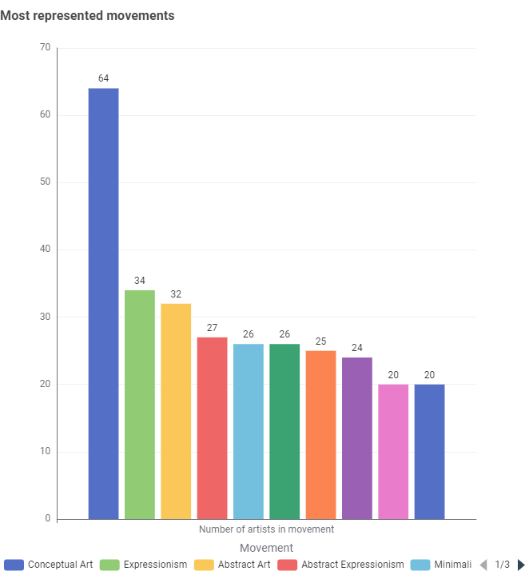
Neo4j queries + Bar chart visualizations
Neo4j

Slide 14
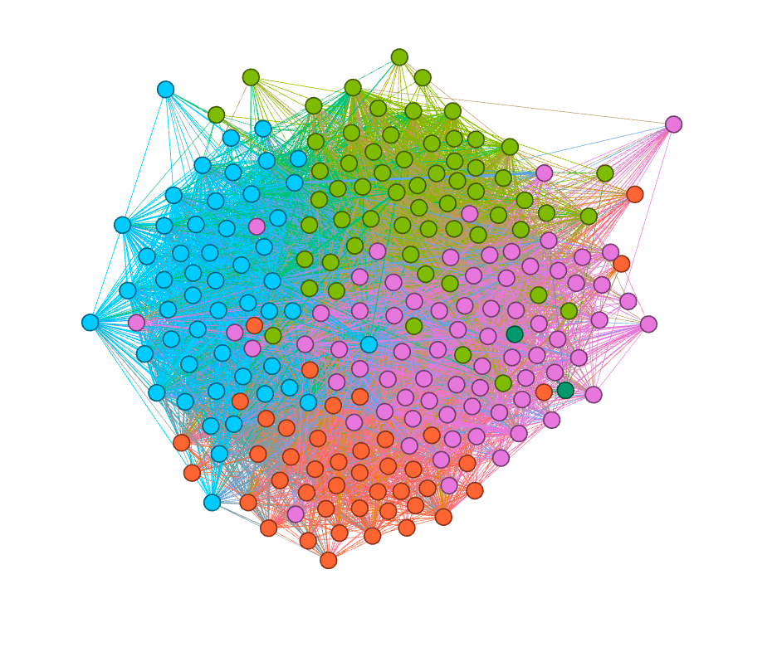
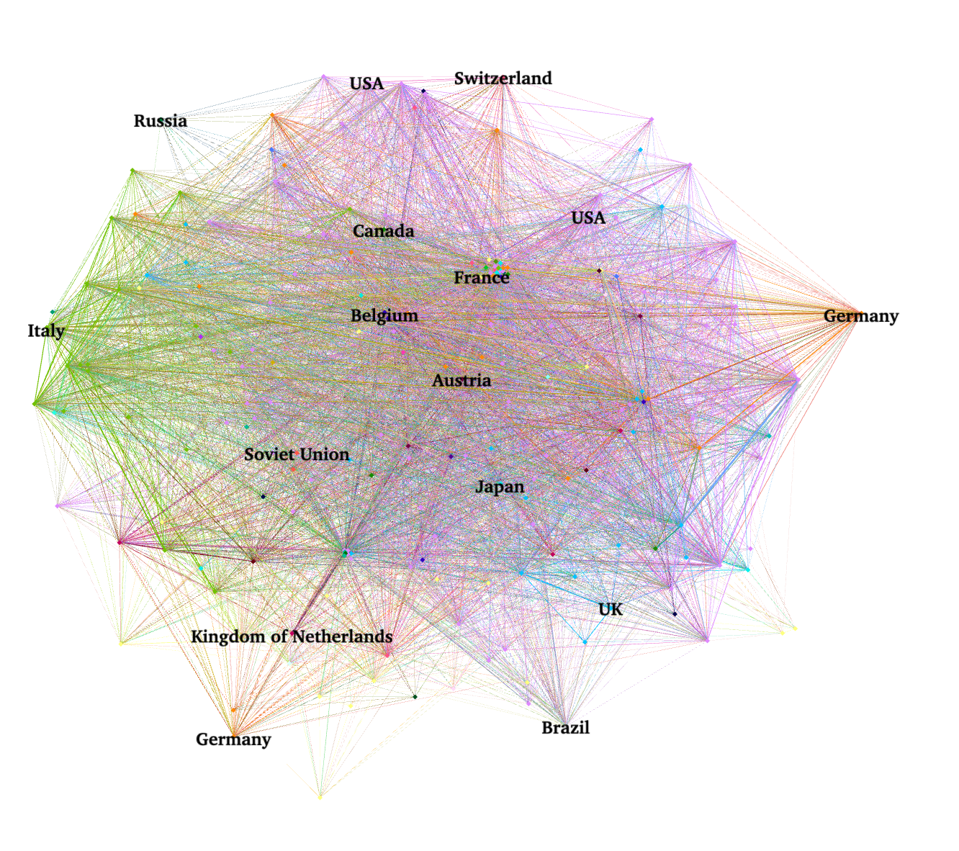
The network visualization in Gephi shows the major communities and networks of artists in a wholistic way
GEPHI
Network visualization of artists based on modularity clustering
Network visualization of artists based on citizenship centrality

Slide 15
The KNIME workflow only processes new information and thus it fulfills ETL criterias
Old Exhibition-artist pairs (B)
Diff Exhibition-artist pairs (B)
Exhibition-artist pairs (B)
Artists (B)
New artist exhibitions
All new coexhibition
Artists (A)
Diff Artists (A)
Matched artists
Neo4j Updates
Old Artists (A)
- Partial outputs

Slide 16
Thank you for your attention!

Slide 17
Q&A

Slide 18
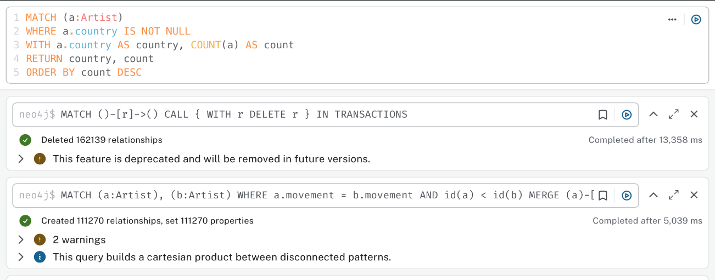
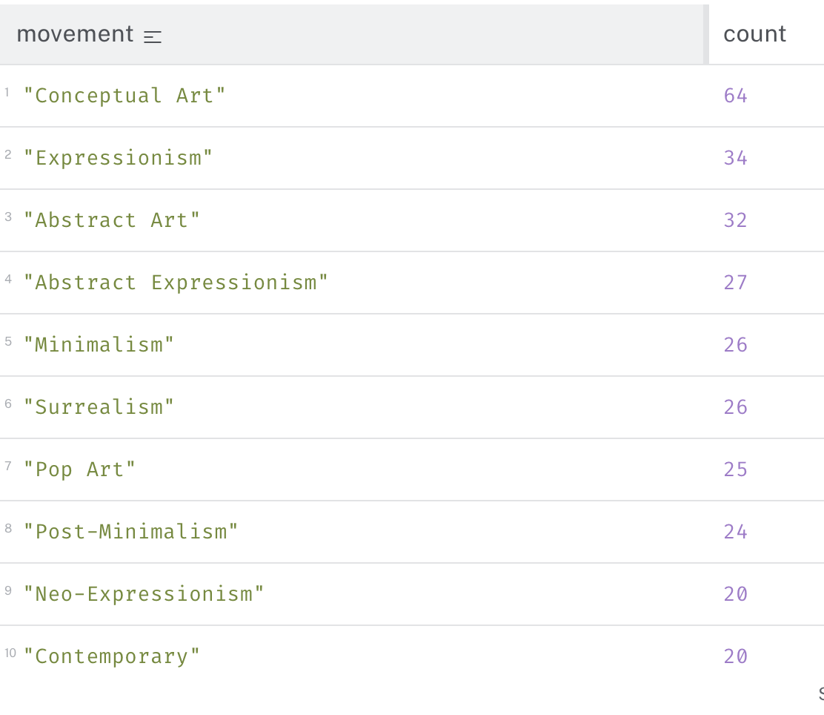
The deployment of Neo4j enabled us to visualize and analyse different dimensions of the network of artists
OVERALL ANALYTICS
Andy Warhol, Liam Gillick and Hito Steyerl are the most frequently exhibited artists in the dataset, accounting more than 750 exhibitions together
Most artists died in New York, while most have been born in Europe, indicating that the creative environment is more secure overseas
Conceptual Art, Expressionism and Abstract Art create the most connections between artist, while 20% hardly accounts any connections

Slide 19
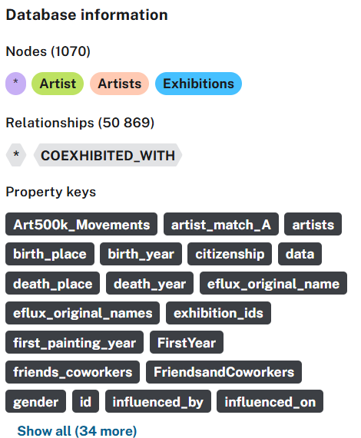
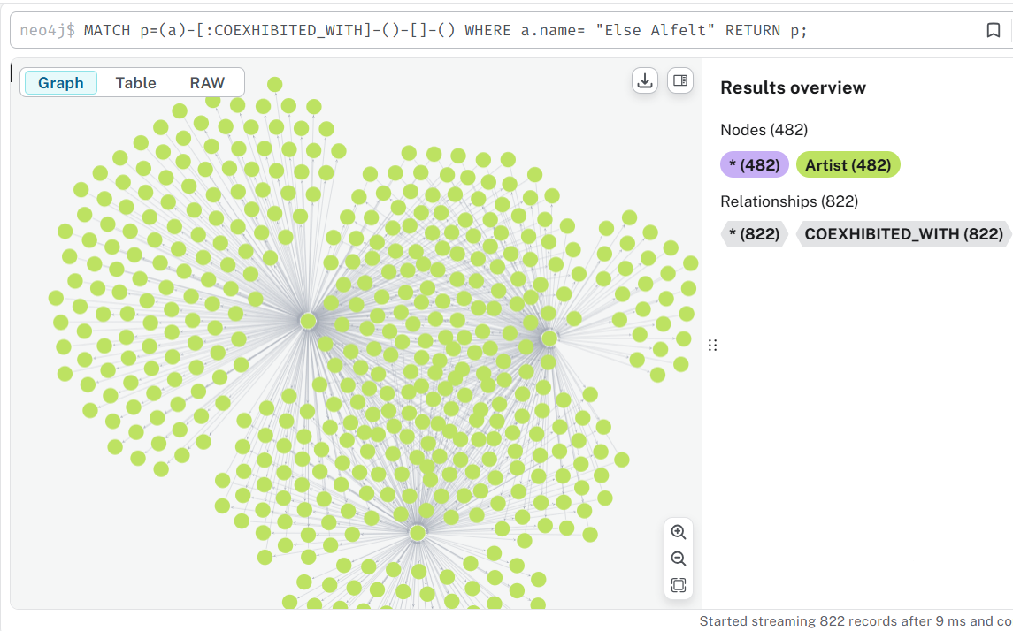

Slide 20
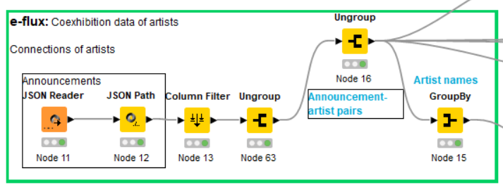
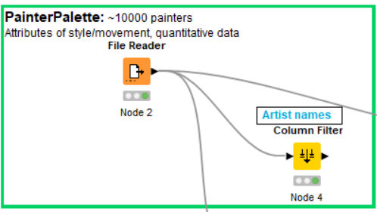

Slide 21
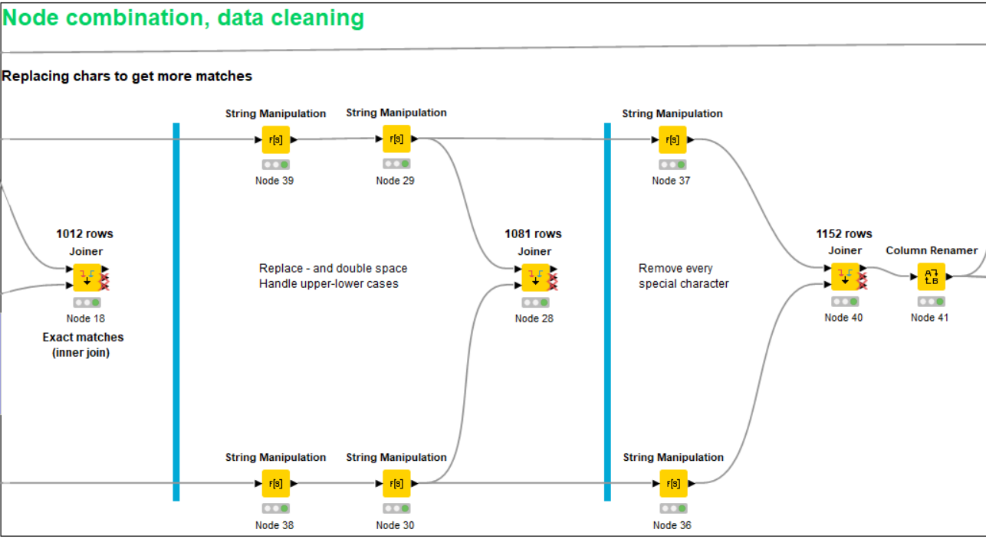

Slide 22
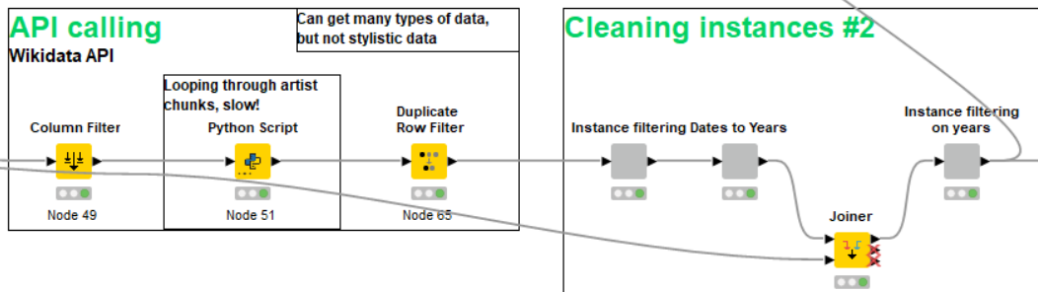

Slide 23
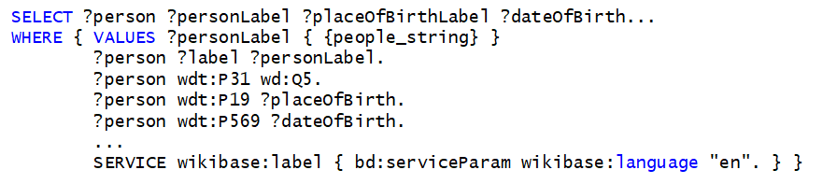
SparQL: Properties, values (identifiers), string labels
Query first paralel, retry missing instances, then retry for all languages
Transform result list of dicts into Pandas dataframe, then KNIME IO table
import knime.scripting.io as knio
data = list(knio.input_tables[0].to_pandas()['name’])
results_dict = query_multiple_people_retry_missing(data)
results_table = pd.DataFrame.from_dict(results_dict)
knio.output_tables[0] = knio.Table.from_pandas(results_table)

Slide 24
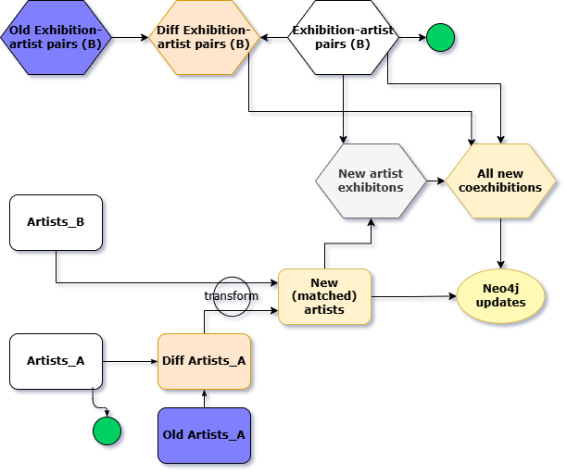

Slide 25
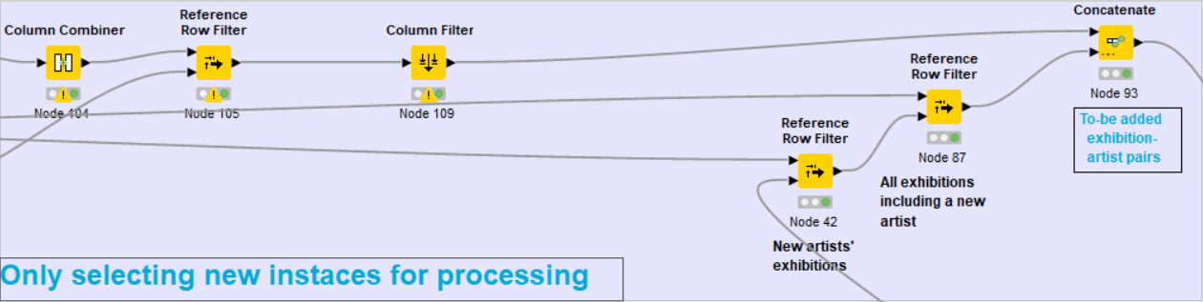
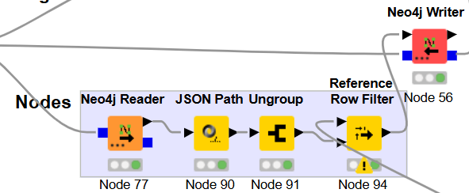

Slide 26
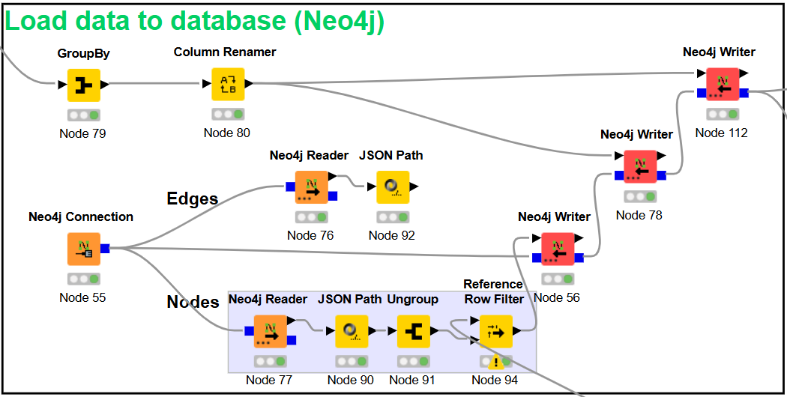

Slide 27
